Slide 1
Beat The Calamity
Disaster Management using Satellite Images and Social Media Analysis
College - R.V. College of Engineering
Team Members : Ramya Ramanathan, Sindhu B Dinesh, Malika Makker

Slide 2
Introduction
Problem Statement : To build a robust disaster management system, which can be used to analyse an area post disaster and to assist the people in distress, by drawing helpful insights from the satellite images and the social media posts of people regarding their state
Our all-in-one disaster management application is used to help ease out the people’s distress during times of calamity by finding roads to safety, locations of stranded people, detection of most affected areas and by providing a mechanism to get supply of necessities to people, thereby providing solutions to people in a multi-faceted way.
Components:
Road Detection in flooded areas.
Stranded people detection.
Detection of damaged areas after a flood.
Identifying items of need through Twitter data.
Provision to map items of need to help centers.
Trend analysis of the twitter feeds.

Slide 3
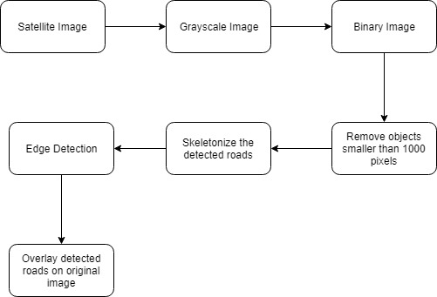
Road Detection

Slide 4
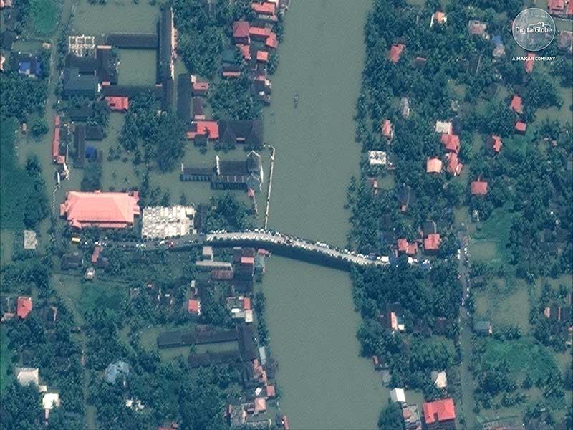
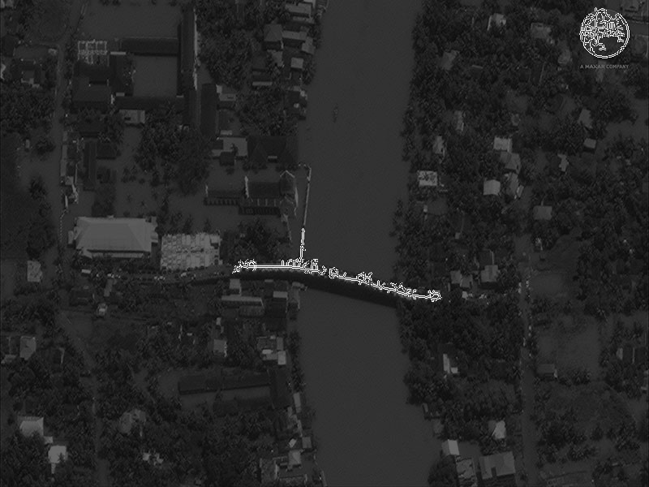
Road Detection

Slide 5
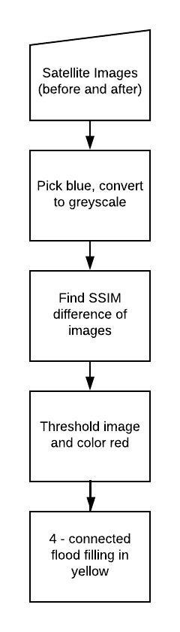
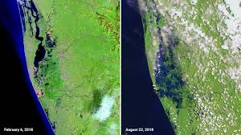
Damage Detection

Slide 6
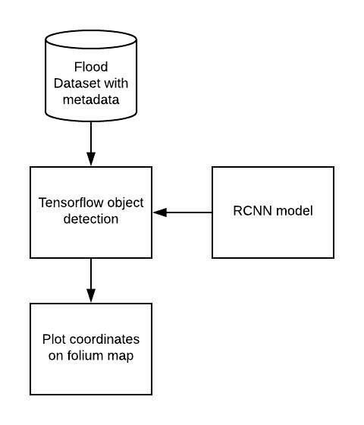
Stranded people detection

Slide 7
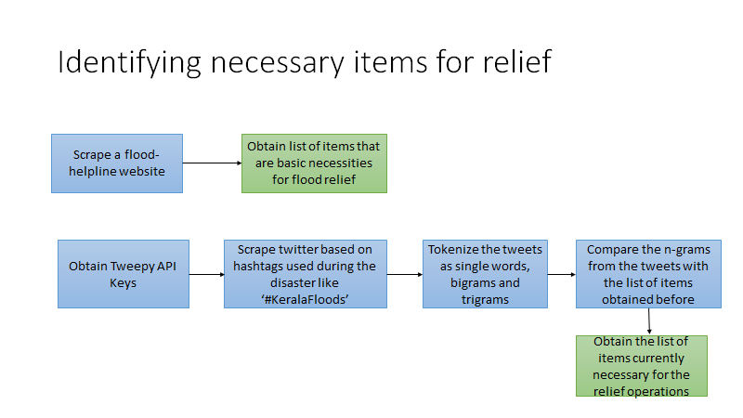

Slide 8
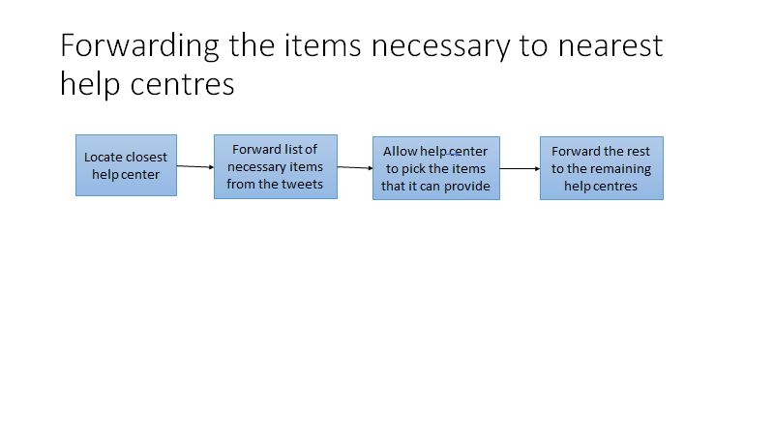

Slide 9
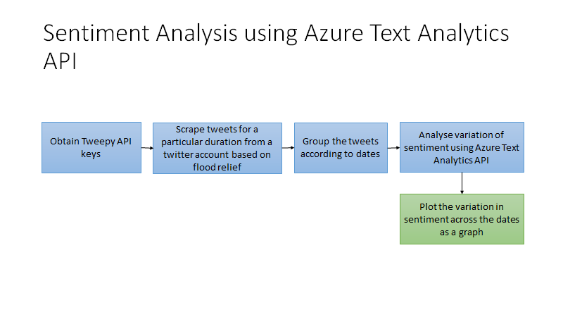

Slide 10
Packages used
Cv2
Pil
Tensorflow
Tweepy
Matplotlib
Re
flask

